Slide 1

Project Title – CNN NEWS TEXT SUMMARIZATION
By Pramodini Karwande (Non Degree Student)

Slide 2

Motivation
News are the day to day part of our lives to get updated and know outside world affairs, events going on.
In the busy schedule in day-to-day life, it is required to have only highlights of the news instead of reading/listening longer news.

Slide 3
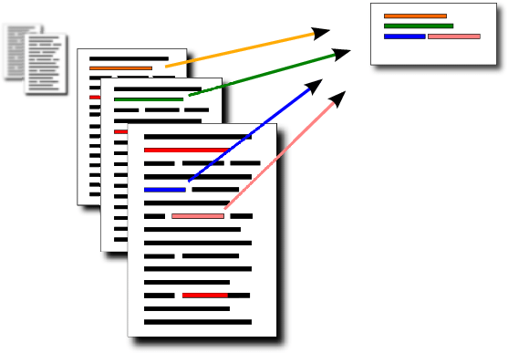
Problem Statement
“I don’t want to read lengthy report, just give me a summary of the results”. I have often found myself in this situation – both in college as well as my professional life. .
We prepare a comprehensive report, and the teacher/senior professionals only has time to read the summary. Sound Familiar?
Many people face similar problem with the News Articles.
Here comes Text Summarizer into picture…
Text summarization is a process of producing brief and concise summary by capturing the vital information and the comprehensive meaning.
To model Text Summarizer that can predict the summary out of long news article, We propose a neural network-based LSTM with Attention Model with better performance

Slide 4
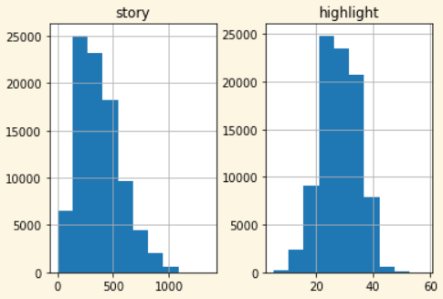
Data
Distribution of word counts of story i.e. article and highlight
Dataset is available on - https://cs.nyu.edu/~kcho/DMQA/
Total CNN Articles – 92580
Article contains Story and Highlights
Distribution of word counts on right denotes that stories use approx. 250 words and highlight use approx. 25 words

Slide 5
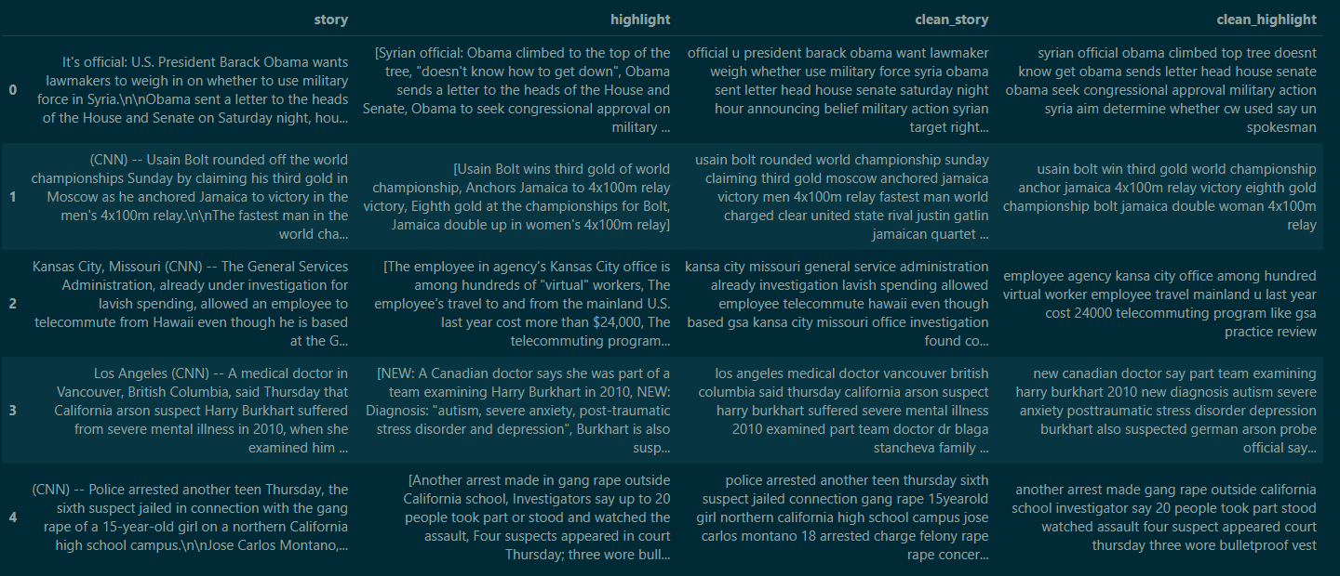
Data Preprocessing
Convert everything to lowercase
Eliminate punctuations and special characters
Remove stopwords
Apply lemmatization

Slide 6
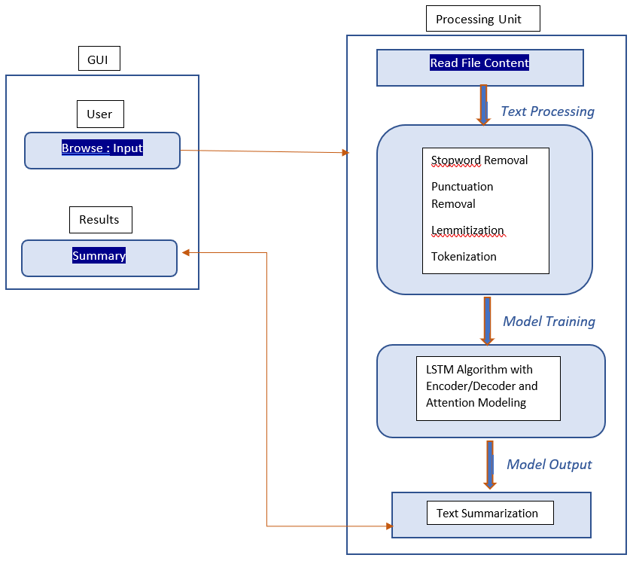
System Architecture
Model : Sequence-to-sequence learning is a training model that can convert sequences of one input domain into the sequences of another output domain.
Encoder : An encoder is an LSTM network which reads the entire input sequence. At each time step, one word from the input sequence is fed into the encoder. It then processes the input at each time step and captures the context and the key information related to the input sequence.
Decoder : The decoder is trained to predict the next word in the output sequence given the previous word based on the contextual memory stored by the LSTM architecture.
Attention Layer : Attention mechanism is used to secure individual parts of the input which are more important at that particular time.

Slide 7
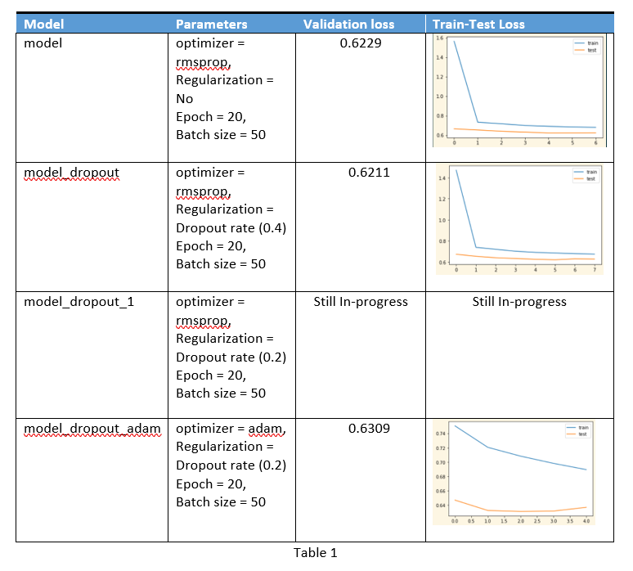
Results Comparison
Minimum validation loss | 0.6211
Optimizers | rmsprop and adam optimizer
Metric | Sparse Categorical CrossEntropy
Regularization | Dropout
Epoch | 20
Batch Size | 50

Slide 8
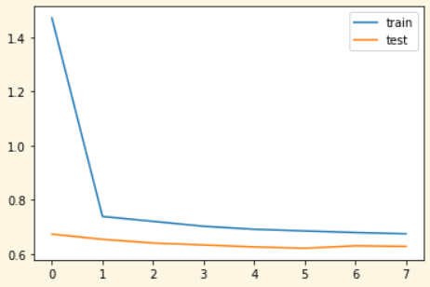
Result Summary
Training and Validation Loss
Validation loss | 0.6211
Optimizers | rmsprop optimizer
Metric | Sparse Categorical CrossEntropy
Regularization | Dropout Rate .04
Epoch | 20
Batch Size | 50

Slide 9
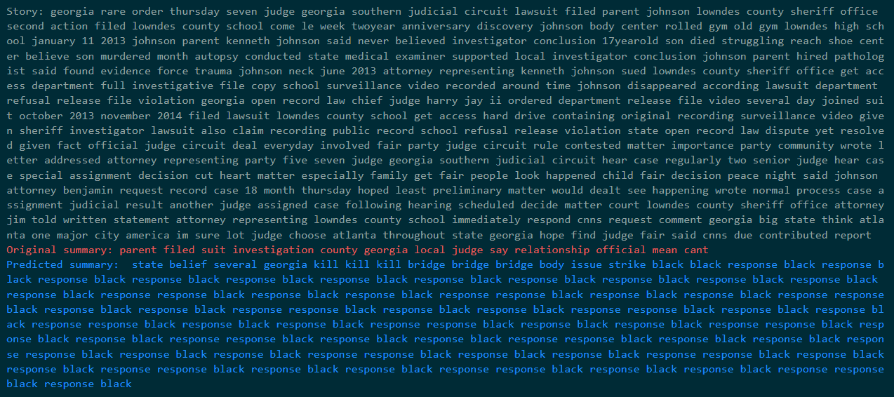
Final Prediction

Slide 10
Scope of Improvements
Our learning doesn’t stop here. We have many aspects that can implement to improve our implementation to get desired results.
Experiment implementation using Bi-Directional LSTM which is capable of capturing the context from both the directions and results in a better context vector.
Use beam search strategy for decoding the sequence to see if that produces better results.
Evaluate performance on different metrics like ROUGH or BLEU score
Implementing pointer-generator networks or pretrained BART model
Using different regularizations or optimizers at varying rates.

Slide 11

End

